Slide 1


Ptrix: Efficient Hardware-Assisted Fuzzing for COTS Binary
Yaohui Chen*, Dongliang Mu*, Jun Xu, Zhichuang Sun, Wenbo Shen, Xinyu Xing, Long Lu, Bing Mao
Notes:
Good morning, everyone. My name is Dongliang Mu. It’s my honor to present our paper - Ptrix: Efficient Hardware-Assisted Fuzzing for COTS Binary. This is a joint work with collaborators from five universities.

Slide 2
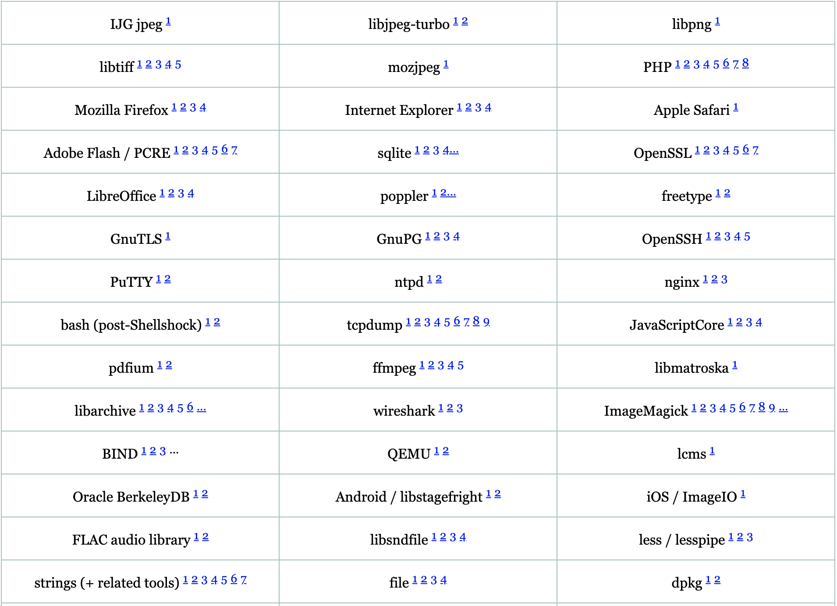
Fuzzing: de facto software testing technique
Automated software testing technique
Feed unexpected inputs to trigger abnormal behaviors
Widely used in the industry and academia
AFL (American fuzzy lop) [1]
Libfuzzer [2]
Why coverage-based fuzzing?
More effective at path exploration without sacrificing time for program analysis
http://lcamtuf.coredump.cx/afl/
Notes:
At the beginning, let me introduce the term - fuzz testing or fuzzing. Fuzzing is the de facto automated software testing technique. It provides invalid, unexpected, or random data as inputs to the target program in order to find bugs inside. Meanwhile, it is widely used in both industry and academic fields. The famous and representative fuzzing tools are AFL and Libfuzzer. They both apply coverage-based fuzzing. Why? Because coverage-based fuzzing is more effective at path exploration without sacrificing time for program analysis. Due to the power of coverage-based fuzzing, AFL found dozens of bugs. This figure is only a part of bugs found by AFL.

Slide 3
Coverage-guided fuzzing
Seed Input
libxmljs/blob/master/src/xml_attribute.cc
Input Queue:
……
bool XmlAttribute::get_namespace() {
Nan::EscapableHandleScope scope;
if (!xml_obj->ns) { return scope.Escape(Nan::Null); } return scope.Escape(
XmlNamespace::New(xml_obj->ns)); }
1st Mutation
…
Nth Mutation
Notes:
Next, I will introduce the workflow of coverage-based fuzzing. First, it requires seed inputs to start fuzzing. Then, we take a seed file and mutate it with operations, such as bit flips. Next, we run fuzzing with the generated testcase and collect the code coverage at runtime. If any new code coverage(like the light green area of code) is found, this testcase is added into the input queue for future round of fuzzing. The same process occurs on the following N Mutations. Finally this loop continues until the fuzzing is terminated.

Slide 4

Binary-only fuzz testing is very slow
Can we replace Dynamic Binary Instrumentation?
Source Code Instrumentation
Dynamic Binary Instrumentation
2-5X Slower [3]
Native Fuzzing
Binary-only Fuzzing
Notes:
In coverage-based fuzzing, when source code is available, native fuzzing is appropriate. It firstly instruments source code and then collects feedback with compiler generated code coverage. However, for binary-only programs, AFL employs dynamic binary instrumentation in QEMU to dynamically trace program execution. According to AFL white paper, Binary-only fuzzing is 2 to 5 times slower than native fuzzing. Now that software tracing is much slower, can we replace the DBI with hardware tracing to collect code coverage?

Slide 5
Intel Processor Trace
A hardware feature that logs information about software execution
Support control flow tracing
Use a decoder to recover the exact flow of software execution
Performance
(<2%)
Coverage Feedback
(Informative)
Notes:
The emergence of Intel PT rescues the situation. Intel PT is a hardware feature that traces software runtime execution. And it only has negligible tracing overhead, less than 2%. The trace information recorded by Intel PT contains all direct and indirect control flow transfers. Thus those trace information could be decoded to recover control flow information and used as coverage feedback.

Slide 6
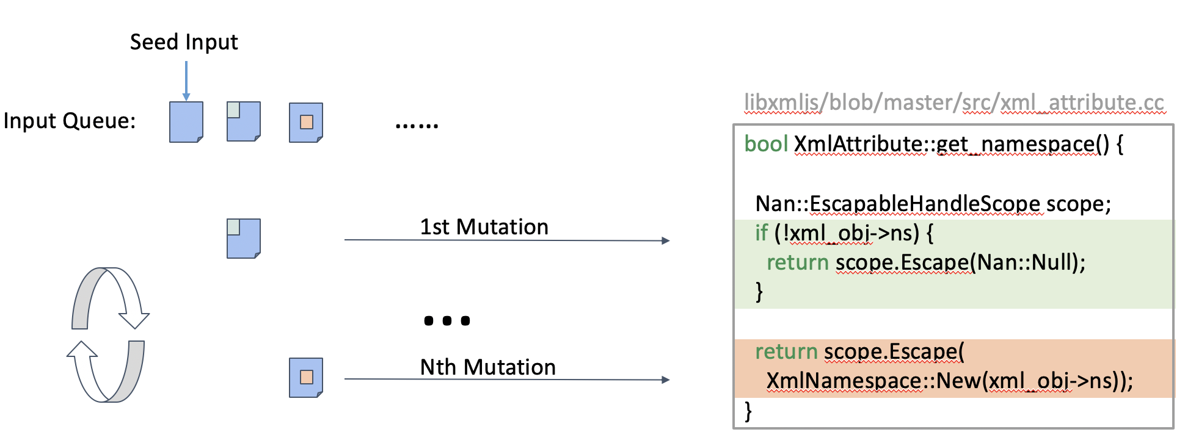




Introducing Ptrix
An efficient hardware-assisted fuzzing tool for binaries
Replace heavy Dynamic Binary Instrumentation(DBI) with Intel PT to extract coverage feedback
Notes:
By replacing dynamic binary instrumentation (e.g., QEMU, Intel Pin) with lightweight hardware tracing, we propose a new fuzzing scheme to enhance the performance of binary-only fuzzing. Then we design and develop Ptrix - an efficient hardware-assisted fuzzing tool for binaries. We recognize we are not the first to apply Intel PT for fuzzing, but we are the first one to use Intel PT for performance improvement of binary-only fuzzing.

Slide 7


Workflow Overview
1
input
3
input
6
coverage
4
exit status
Proxy
Program
Fuzzer
2
5
begin tracing
end tracing &
get PT trace
How to convert PT trace
to coverage feedback?
Branch Coverage?
iPT Tracer
Notes:
In this slide, we will give an overview of our whole workflow. As we already show the logic of coverage-based fuzzing, we only emphasize these components added or modified by Ptrix. At first, the fuzzer forwards the input to our proxy, then our proxy starts Intel PT tracer to record program execution. After that, the proxy feeds the input to the target program, and then wait until it terminates. Next, the proxy stops recording and gets the PT trace. From the PT trace, our proxy collects code coverage and then decides if this input is good or not. The 1-6 steps form one loop to test each input. In our experiments, we observe that converting trace to coverage is the most time consuming part in the whole loop. So one question comes: how to convert PT trace to code coverage feedback? Should we still use branch coverage?

Slide 8
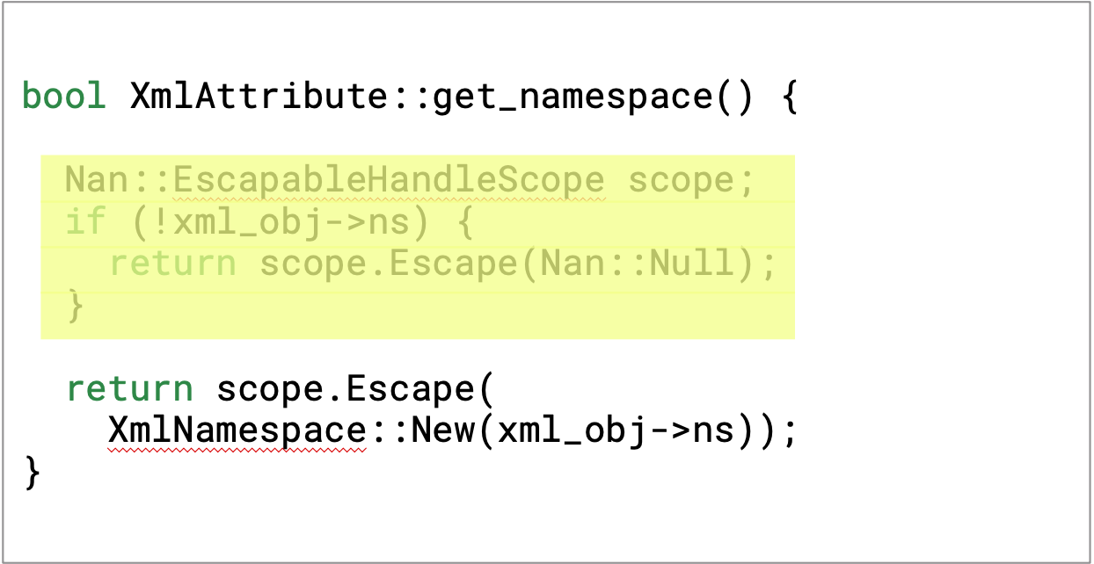
Feedback #1 - extract branch coverage
Step 1: Parse raw PT trace
Standard but slow!
Used by previous fuzzers
Raw Trace
PT Packets
PT Parser
Step 2: Parse PT packet with program binary
PT Packets
Disassembler
Program
Notes:
Feedback 1: extract branch coverage. At first, we parse raw PT trace to PT packets with our decoder. Second, we combine the PT packets and the target program together and do disassembling. Finally, it returns us all the instructions executed at runtime. This process is used by previous fuzzers. It’s standard, but much slower. So we develop a new feedback scheme.

Slide 9

Feedback #2 - extract slices coverage
Step 1: Parse raw PT trace
A slice is the hash product of a sequence of direct and indirect control flow transfer targets.
These information is naturally encoded in PT Packets.
Raw Trace
PT Packets
PT Parser
PT-friendly - No binary parsing
More sensitive than branch coverage
Step 2: and DONE!
IS
PT Packets
Slice coverage
Notes:
The second feedback is to extract slices coverage. The first step is the same – decoding PT trace to get all the PT packets. And the second step is done as PT Packets are naturally slice coverage. The slice is the hash product of a sequence of direct and indirect control flow transfer targets. All those information is naturally encoded in the PT packets. Finally our new coverage feedback is PT-friendly as we don’t need binary parsing, meanwhile, we are more sensitive than branch coverage.

Slide 10
The advantage of slices coverage
A slice is the hash product of a sequence of direct and indirect control flow transfer targets.
{E1 → E3}
{E1 → E4 → E5}
{E1 → E4 → E6 → E7 → E9}
{E1 → E4 → E6 → E8 → E1 → E3}
{E1 → E4 → E6 → E8 → E1 → E4 → E6 → E8 → E1 → E3}
{E1 → E4 → E6 → E8 → E1 → E4 → E5}
Notes:
As we mentioned before, The slice is the hash product of a sequence of direct and indirect control flow transfer targets. Let me use a real world example to show the advantage of slice coverage. Look at the partial control flow graph in the right. We represent each edge with E1, E2 and so on. Those execution paths could be represented by slices mentioned before. Take the first path (E1->E3) as example, we could use two PT packets with true branches to present. However, when this interesting path in red comes, all the edges are already covered by the previous testcases and then it will be discarded. But in fact, permutating this input would result in a valid path to trigger one bug.

Slide 11
Compare with Prior works using Intel PT
 | Coverage extraction speed | Coverage sensitivity
kAFL [4] | Slow - Binary Parsing | Medium
Honggfuzz [5] | Fast - No Binary Parsing | Low
Ptrix | Fast - No Binary Parsing | High
Notes:
After introducing the workflow of Ptrix, we compare previous works in two dimensions – coverage extraction speed and coverage sensitivity.
kAFL is published at Usenix Security 17 and leverages Intel PT to fuzz OS kernel. It has a low speed in extracting code coverage, but it has a medium coverage sensitivity. Honggfuzz is a google fuzzing tool that leverages PT for fuzzing. Although it is fast in coverage extraction speed, it is less sensitive than other works. Our Ptrix could get the fast extraction speed and the high sensitivity at the same time.

Slide 12
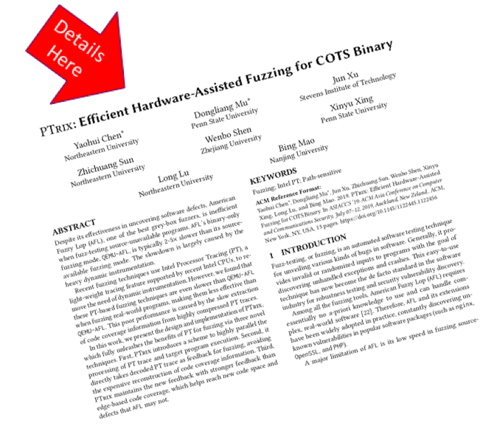
Other efficiency optimizations
Parallel and Elastic PT Parsing
use separate thread to decode PT packets
adjust decoding speed based on program execution
Better cache locality and less collision
And other cool techniques
Fork server mode
etc...
Notes:
Other than our PT-friendly feedback scheme, we also apply parallel and elastic PT Parsing. In detail, we use separate thread to decode PT packets, meanwhile adjust decoding speed based on the program execution. Then we could achieve better cache locality and less collision. In addition, we support other cool techniques, including fork server mode. Due to time limitation, please refer to our paper for more information.

Slide 13
Evaluation
Q1: Can Ptrix achieve higher fuzzing speed?
Q2: Can Ptrix be more effective in fuzzing?
Notes:
In the evaluation part, we try to answer the following two questions: Q1. Can Ptrix achieve higher fuzzing speed? Q2: Can Ptrix be more effective in fuzzing?

Slide 14
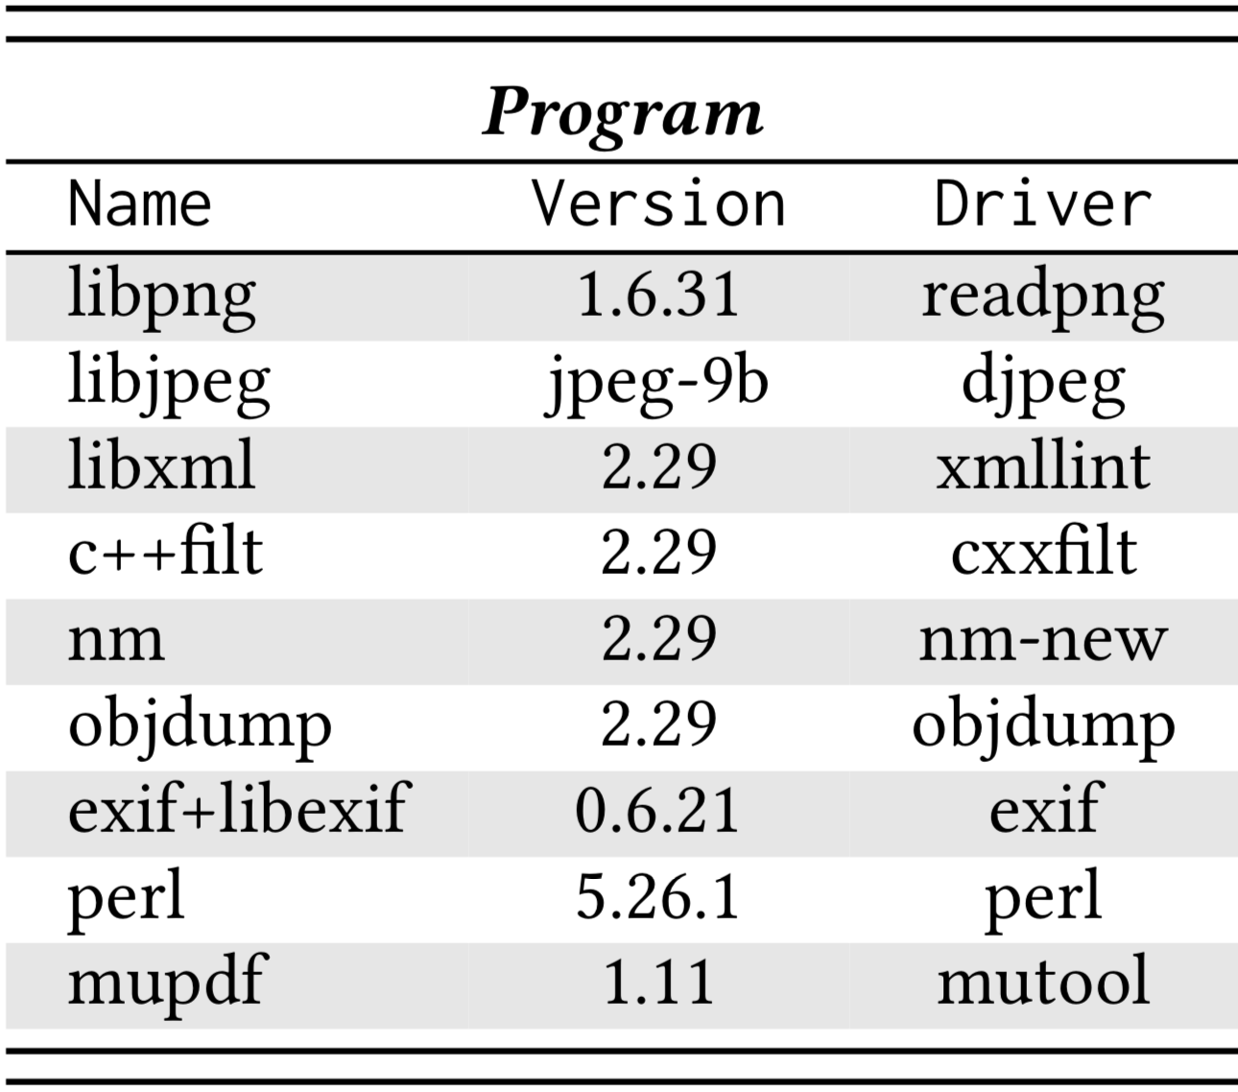
Evaluation Setup
Benchmark
Answer Question 1
Measure our execution speed and compare Ptrix with Qemu-AFL, Edge-PT¹, PTFuzzer [6]
Answer Question 2
Measure our code coverage in 72 hours
Edge-PT is a ported version of kAFL that supports user space application
Notes:
To support our evaluation, we selected a set of 9 programs as our benchmark. Details about these programs are shown in the right table. All these programs are commonly used for fuzzing evaluation. To answer Question 1, we measure our execution speed and compare Ptrix with Qemu-AFL, Edge-PT and PTFuzzer. It is noteworthy that Edge-PT is a ported version of kAFL that supports user space application. To answer Question 2, we measure our code coverage in 72 hours.

Slide 15
Execution Speed Evaluation
Notes:
To show how fast Ptrix is, we compared its execution speed with QEMU-AFL, Edge-PT, and PTFuzzer. In this figure, we show the evaluation results with PTrix as baseline. And the numbers tied to other bars are the ratio compared with Ptrix. On average, PTrix ran 4 times, 26 times, and 55 times faster than QEMU-AFL, Edge-PT, and PTFuzzer, respectively.

Slide 16
Code Coverage Evaluation
Perl
libpng
objdump
nm
Notes:
In order to measure code coverage, we run Ptrix and Qmu-AFL at the same time for 72 hours. From the figures, we can see that Ptrix could get more code coverage quickly and effectively, compared with Qemu-AFL.

Slide 17
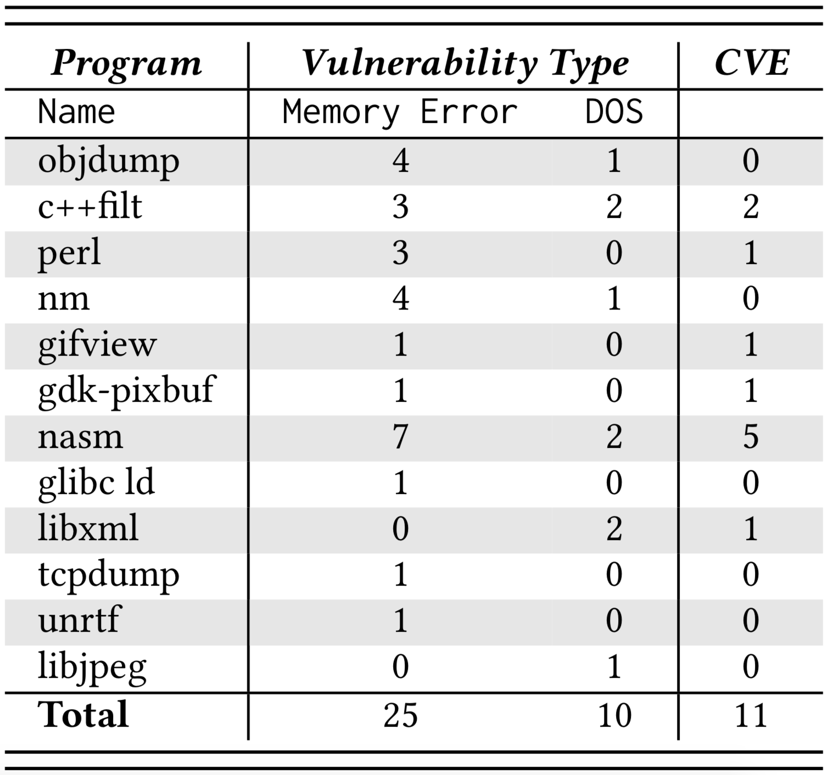
Bugs found by Ptrix
25 memory error vulnerabilities
10 Denial-of-Service (DoS)
11 CVE No. are assigned already
Notes:
Ptrix triggered 19 thousands of unique exceptions — crashes and hangs in 24 hours. We manually analyzed a subset of them and confirmed 35 vulnerabilities. Among those vulnerabilities, 25 memory error vulnerabilities and 10 Denial-of-Service (DoS). Moreover, we receive 11 CVE Numbers for those bugs.

Slide 18
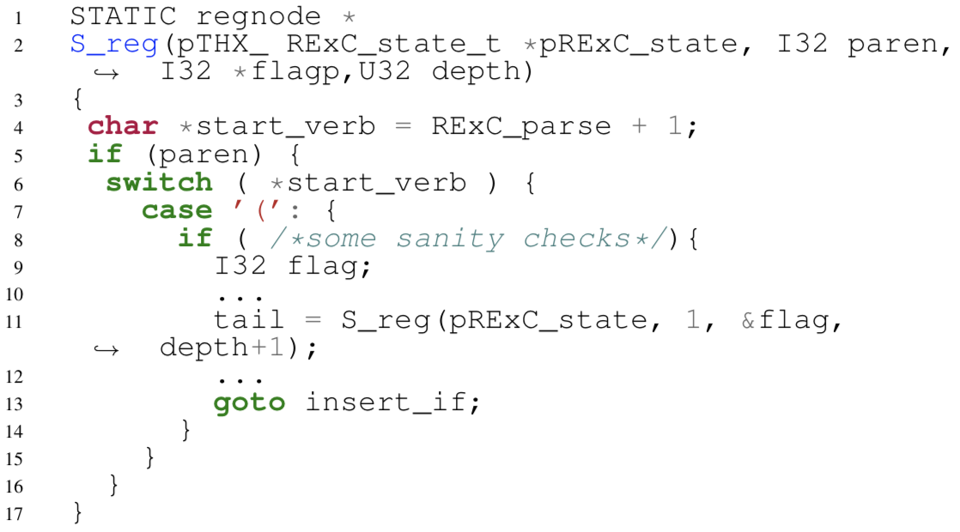
Case study: Stack Exhaustion in Perl
With an input containing over 3500 “(”, one can trigger a stack exhaustion error.
Each of those “(” would trigger a recursive call to function S_reg at Line 11, which gradually exhausted the stack region.
Notes:
Further to show the power of Ptrix, we will detail two concrete bugs. The first case is a stack exhaustion in Perl. <Detailed information on the left> With our slice coverage, we could find this bug that AFL misses.

Slide 19
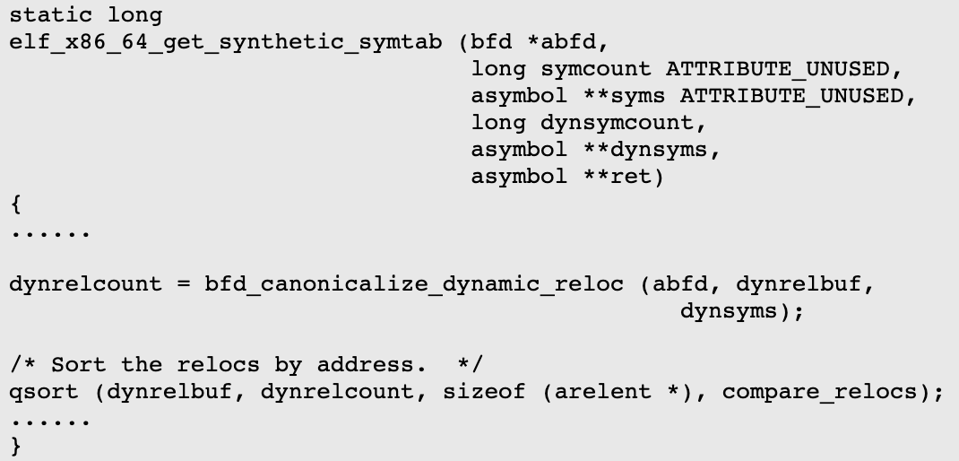
Case study: Integer Overflow in objdump
bfd_canonicalize_dynamic_reloc may return -1 when exception happens.
qsort wrongly casts -1 to the largest unsigned value and ultimately incurs out-of-bound memory accesses.
Notes:
The second case is an Integer Overflow in Objdump. When exeception happens, the function with underline returns -1. Then qsort wrongly casts -1 to the unsigned value and causes out-of-bound memory access. This case is like our previous example, so AFL misses it, but we could find it.

Slide 20
Conclusion
Fuzz testing source-unavailable programs is very slow
Ptrix takes advantage of Intel PT with new slice coverage feedback
Our evaluation shows Ptrix can find very subtle bugs in the real world
Notes:
Our conclusion is as follows: <repeat conclusion>

Slide 21
Source Code Sharing
Github Repo: https://github.com/junxzm1990/afl-pt
PT Module
Parallel and Elastic PT Parsing
Our customized AFL
PT-friendly coverage feedback
PDF on arXiv: https://arxiv.org/abs/1905.10499
Notes:
For the benefit of the whole security community, we open source our tool – Ptrix at Github. We have two key parts – one is PT module, and another is our customized AFL.

Slide 22
Q & A
Name : Dongliang Mu
Homepage : http://mudongliang.me/about/
Github Account : mudongliang
Institution: Penn State University & Nanjing University
Email : dzm77@ist.psu.edu
Notes:
Thank you very much for joining my talk. And I am happy to take questions.

Slide 23
References
[1] Zalewski, Michal. "American fuzzy lop." (2014).
[2] Serebryany, K. "libFuzzer a library for coverage-guided fuzz testing." LLVM project (2015).
[3] Zalewski, M. "Afl technical details." (2017).
[4] Schumilo, Sergej, et al. "kAFL: Hardware-Assisted Feedback Fuzzing for OS Kernels." 26th USENIX Security Symposium (USENIX Security 17). 2017.
[5] Swiecki, Robert. "Honggfuzz." Available online a t: http://code. google. com/p/honggfuzz (2016).
[6] Zhang, Gen, et al. "Ptfuzz: Guided fuzzing with processor trace feedback." IEEE Access 6 (2018): 37302-37313.

Slide 24
Backup: Potential Questions
Comment on the new qemu-afl improvements
we are experimenting with new qemu-afl. thank you for the info.
About using extra core for decoding

Slide 25
An Overview of AFL Internal Mechanism
Notes:
Exploit how AFL works. The difference between source code mode and qemu mode is the method to collect runtime code coverage. For QEMU mode, AFL performs dynamic instrumentation using the user-mode emulator of QEMU to trace program and collect runtime code coverage. Why not static binary instrumentation? Because it could potentially introduce unexpected errors.

Slide 26
Overview of Ptrix

Slide 27
Intel PT
Intel PT is a hardware feature which records runtime execution and store the execution trace in a form of compressed binary packets.
Basic Packet Types:
TNT (Taken Not Taken)
TIP (Target IP)
Notes:
Explain Intel PT with the right example

